Slide 2
Tips and tricks to get the most out of your Azure virtual machines
BRK3296
Drew McDaniel
Principal Lead Program Manager
Azure Virtual Machines

Slide 3

Agenda
Getting Away from Classic VMs
Selecting the Right VM Configuration
VM Deployment Strategies
VM Management Strategies
Troubleshooting and Optimizing

Slide 4
Getting Away from Classic VMs

Slide 5
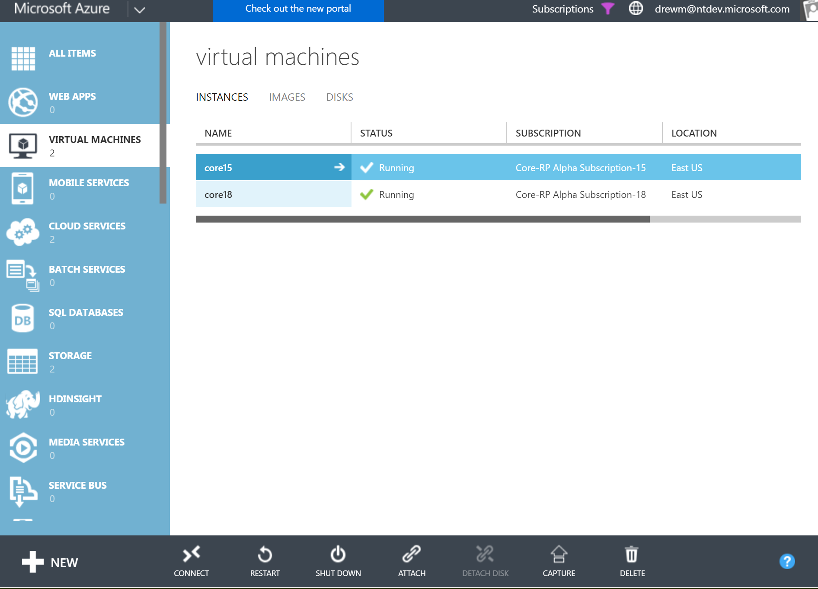
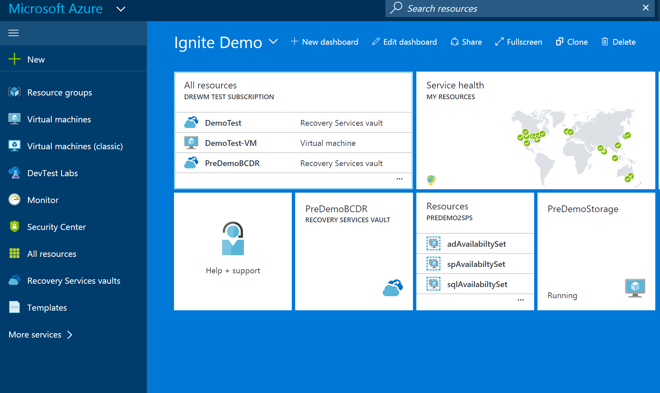
Two Management Stacks
Azure Resource Manager
Classic APIs
CRP
NRP
SRP
Common Compute Resources
VM1
VM2

Slide 6
Start: Classic Resources Only [Read/Write]
Validate
Prepare
Abort
Migration Process
Migrating: Classic and ARM Resource [Read Only]
Commit
Complete: ARM Resources Only [Read/Write]

Slide 7
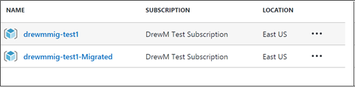
Migration Example
APIs locked
Azure Resource Manager
Classic APIs
CRP
NRP
SRP
Commit
Prepare
Validate
Selected VNET & VMs are validated
Removal of classic state
Migration of state
VM1
VM2

Slide 8
Platform Migration Details
VMs in VNet
Scope of migration is VNet
Platform migrates the VNet along with the VMs in that VNet
No VM downtime during this migration
VMs not in VNet
Scope of migration is Cloud Service
VM will incur downtime during the migration
VMs will move into a VNet in the Resource Manager stack

Slide 9
Post Migration Changes
Related Session
THR2265 (Tue)
Experience/Contract Changes
Certificates – Moves from Hosted Services to Azure Key Vault
Endpoint ACLs – Moves into Network Security Groups
Internal DNS – iDNS Suffixes changes from the current model to a modified version. Name resolution will continue to work.
Tooling Changes
PowerShell/CLI or any other Automation built on these resources

Slide 10
Selecting the Right VM Configuration

Slide 11
VM Configuration Options
Computational performance
1 vCPU - 128 vCPUs
Memory
1 GiB - 4 TiB
Disk storage
4GiB - 64TiB
Up 160,000 IOPs
Networking
30 Gb Ethernet 100 Gb InfiniBand
Availability
Single VM SLA 99.9% Multi AZ SLA 99.99%

Slide 12

Computing options for every workload
VIRTUAL MACHINES
PURPOSE-BUILT
Entry level
Burstable
General Purpose
Compute intensive
Memory optimized
GPU accelerated
High Performance Computing
Storage optimized

Slide 13
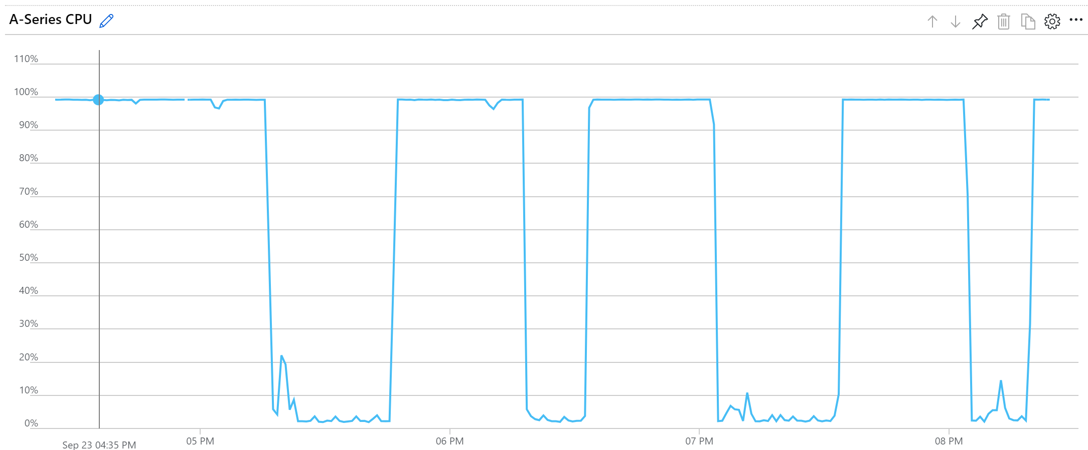
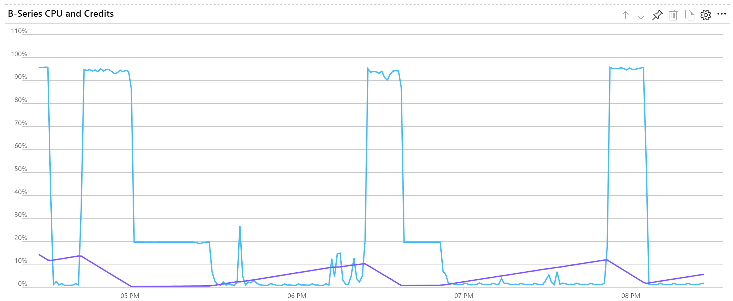
Entry Level
Computational performance
1 vCPU - 128 vCPUs
Av2
B
Size | vCPU's | Base CPU Perf | Max CPU Perf | Credits Banked / Hour | Max Banked Credits
B1s | 1 | 10% | 100% | 6 | 144
B1ms | 1 | 20% | 100% | 12 | 288
B2s | 2 | 40% | 200% | 24 | 576
B2ms | 2 | 60% | 200% | 36 | 864
B4ms | 4 | 90% | 400% | 54 | 1296
B8ms | 8 | 135% | 800% | 81 | 1944
Prem
Av2-Series: CPU Usage
B-Series: CPU Usage and Credits

Slide 14
Right Sizing for B-Series

Slide 15
Entry Level
Trick: Increase pagefile size if using Windows on B1s
Computational performance
1 vCPU - 128 vCPUs
Related Session
BRK2310 (Wed)
Tip: B-Series is lowest per vCPU price
Trick: D15v2 only runs on limited hardware
100 ACU/vCPU
$0.36/kACU
~21 ACU/vCPU
$0.57/kACU
Tip: Dv2 is slightly better in $/ACU than Dv3
Av2
B
Prem
General
Purpose
210 ACU/vCPU
$0.27/kACU
160 ACU/vCPU
$0.30/kACU
160 ACU/vCPU
$0.42/kACU
Tip: Fv2 has the best price/perf mix
Dv2
Dv3
Ev3
Prem
Prem
Prem
Compute Optimized
195 ACU/vCPU
$0.22/kACU
290 ACU/vCPU
$0.33/kACU
Coming
Soon
Coming
Soon
Fv2
H
HB
HC
Prem
Prem
Prem
ACUs
N/A for
GPUs
ACUs
N/A for
GPUs
ACUs
N/A for
GPUs
ACUs
N/A for
GPUs
ACUs
N/A for
GPUs
GPU
Computing
NC
NCv2
NCv3
ND
NDv2
Prem
Prem
Prem
Prem

Slide 16
Disk storage for every workload
Related Sessions
BRK2375 (Tue)
BRK3299 (Thu)
Tip: Disk type can be changed on stopped VMs to save $$
Now GA
Coming Soon
Standard HDD
Standard SSD
Premium SSD
Ultra SSD
Single disk max value
Low-cost storage
Consistent performance
High performance
Sub-millisecond latency
SIZE
32TiB
32TiB
32TiB
64TiB
IOPS
2,000
2,000
20,000
80,000 – 160,000
BANDWIDTH
500 MBps
500 MBps
750 MBps
2,000 MBps

Slide 17
Standard_DS1_v2 with 2 P30 Disks
Standard_DS2_v2 with 2 P30 Disks
Standard_DS4_v2 with 2 P30 Disks
Standard_DS1_v2
Virtual Machine
Standard_DS2_v2
Standard_DS4_v2
Uncached
Disk
Cached
Disk
Local
Disk
Premium Storage Caching
5k IOPS, 200MB/s
5k IOPS, 200MB/s
Disk Provisioning
Disk Provisioning
4k IOPS, 32MB/s
SSD Provisioning
8k IOPS, 64MB/s
32k IOPS, 256MB/s
Cache Miss
Cache Hit
Server
SSD
6,400 IOPS, 96MB/s
25,600 IOPS, 384MB/s
3,200 IOPS, 48MB/s
VM/Network Provisioning
Managed Disk
Managed Disk

Slide 18
Primary VM
Caching VM
Caching VM
Local
Disk
Local
Disk
Local
Disk
Write
Accelerator
(M-Series Only)
Trick: Write accelerator only supports up to 32 KiB
Managed Disk

Slide 19
Storage Performance

Slide 20
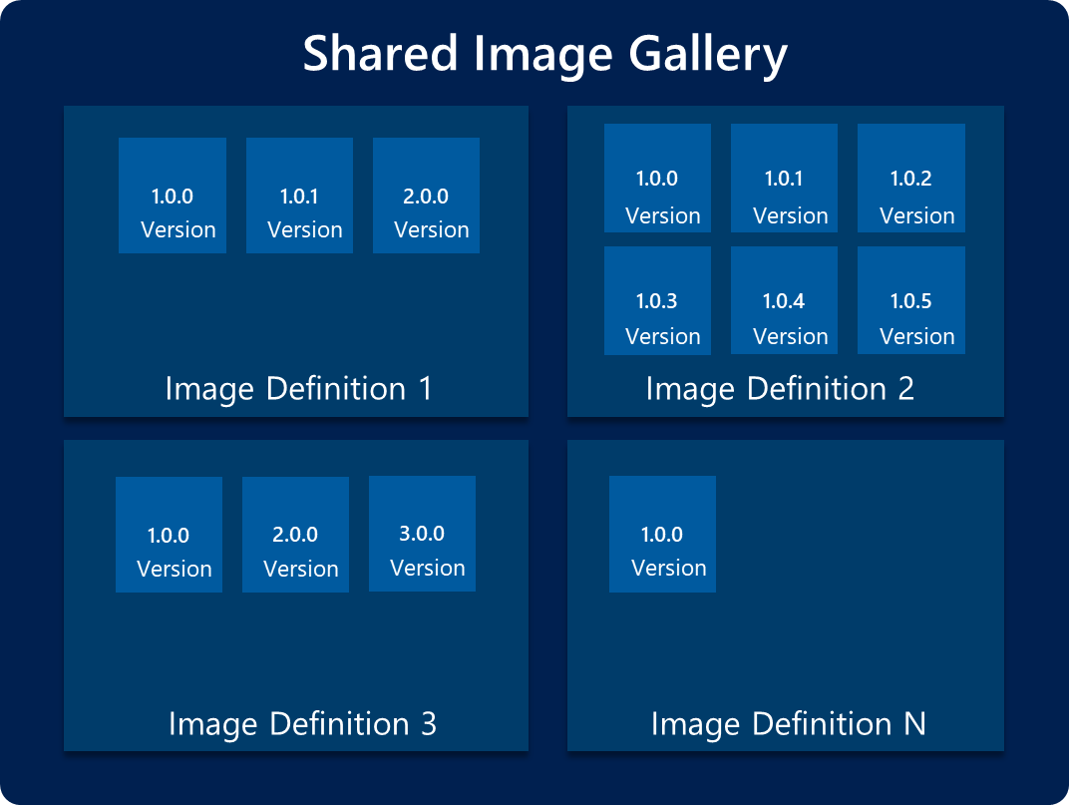
VM OS Disk Sources
Related Session
BRK3178 (Tue)
Azure Platform
Scalability
Platform Image
10,000s of VMs
Marketplace Image
1000s of VMs
Customers
Custom Image
100 - 300 VMs
OS Disk
1 VM
Cost
Low Cost
High Cost

Slide 21
VM OS Disk Sources
Related Session
BRK3178 (Tue)
Azure Platform
Scalability
Customers
Platform Image
10,000s of VMs
Marketplace Image
1000s of VMs
Custom Image
10 - 20 VMs
OS Disk
1 VM
Cost
Low Cost
High Cost

Slide 22
VM Deployment Strategies

Slide 23
High Availability and Disaster Recovery
Related Session
BRK3336 (Thu)
Higher Latency
Region 1
Region 2
Region pairs
Protection from disaster with Data Residency compliance
Availability zones
Protection from entire datacenter failures
Availability sets / VM Scale Sets
Protection against failures within datacenters
Increased resiliency

Slide 24
Server Models
Pets
Cattle
Server treated as unique, indispensable systems
Limited automation
Typically smaller numbers of servers
Deployed and managed through automation
Instances can easily be replaced on failure or problem
May leverage auto-scaling
History of Pets vs Cattle: http://cloudscaling.com/blog/cloud-computing/the-history-of-pets-vs-cattle/

Slide 25

VM Deployment Models
Single instance VM
Simple VM with no HA
Two or more instances in Availability Set
Rack-based HA for "Pet" of VM
Two or more instances in Availability Zones
Zone-based HA for "Pet" VMs
VM Scale Set in one zone
Rack-based HA for "Cattle" VMs
Multi-zone VM Scale Set
Zone-based HA for "Cattle" VMs

Slide 26
Pets
Cattle
Datacenter/AZ
Availability Set

Slide 27
Pets (Loose VMs)
Cattle
Datacenter/AZ
Availability Set
Datacenter/AZ
Datacenter/AZ

Slide 28
Pets (Loose VMs)
Cattle
Datacenter/AZ
Datacenter/AZ
Datacenter/AZ
Datacenter/AZ

Slide 29
Pets (Loose VMs)
Cattle (VMSS)
Datacenter/AZ
Datacenter/AZ
Placement Grp
Placement Grp
Placement Grp
Datacenter/AZ
Datacenter/AZ

Slide 30
Tip: Use VMSS for large deployments. ☺
Pets (Loose VMs)
Cattle (VMSS)
Tip: Pets have more integrated tooling today: backup, ASR, …
Datacenter/AZ
Datacenter/AZ
Placement Grp
Placement Grp
Placement Grp
Datacenter/AZ
Datacenter/AZ
Placement Grp
Placement Grp
Placement Grp
Datacenter/AZ
Datacenter/AZ
Placement Grp
Placement Grp
Placement Grp

Slide 31
Why choose VM Scale Sets (VMSS)?
Trick: Some management operations not available on VMSS yet
Elasticity of VMs in the cloud with Autoscaling
Auto scale-out and scale-in based on health metrics, custom metrics
Cross-zonal deployment of VMs, and across fault-domains
Templatized, optimized for concurrency, and scale
Deploy 1000s of identical VMs concurrently
Collection of VMs managed as a single entity
Integration with Azure Application Gateway, and Software Load balancer
Change management orchestration
Update management, auto-OS image update for guest images

Slide 32
Larger VMSS Deployments
Related Session
BRK3339 (Wed)
Multi-Placement Group
Fault Domain Count
Over-Provisioning
Enable multiple placement groups unless data alignment to fault domains is critical (e.g. NoSQL database)
Required if VMSS > 100 instances
Set FD=1 for stateless workloads for maximum availability and successful deployments
Set FD=5 for stateful workloads with data placement requirements (Note: support for FD=2-3 coming)
Overprovisioning will deploy slightly more VMs than requested, and then delete the unneeded VMs once the target has been reached.
Enable overprovisioning unless the workload starts executing as soon as an instance comes up.

Slide 33
VMSS Deployment

Slide 34
VM Management Strategies

Slide 35
Software Patching Strategies
In-Place Updates
Image-based Update
Manual or automated process used to discover when updates are available and apply them to the VM(s)
Possible failures: Download failures / Install failures
Failures are reported to server administrators to investigate
Automated roll-back may not be possible
Primary pattern used for "Pet" type VMs
OS disk for VM or VMSS instance is replaced with a new image with all required patches already applied to the image
No download failures
Can automatically roll-back to previous OS disk if configured
Primary patter used for "Cattle" type VMs

Slide 36
VMSS Auto-OS Guest Image Update
Tip: Now Generally Available
Related Session
BRK3339 (Wed)
Rolling guest-OS image updates
VM extensions are run after image update
Persistent data disks remain
"properties": {
"upgradePolicy": {
"Mode": "Rolling",
"automaticOSUpgrade": "true"
…
Get latest platform image for given SKU
Check OS upgrade
Ubuntu: 18.04 LTS / 16.04 LTS
CoreOS Stable
Windows: 2012R2 / 2016 / 2016 small-disk / 2016 containers
CentOS 7.5
Auto OS Upgrader
…
ID: Instance0
OS: Win2016 Jan
Power:
Extensions:
ID: Instance1
OS: Win2016 Jan
Power:
Extensions:
ID: Instance9
OS: Win2016 Jan
Power: ☑
Extensions: ☑
☑
☑
☑
☑
☑
☑
☑
☑

Slide 37
Managing Updates

Slide 38
Optimizing for Costs

Slide 39
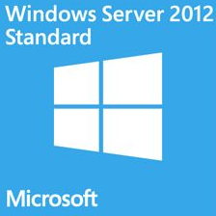
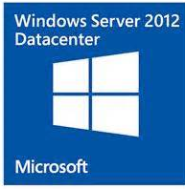
Azure Hybrid Benefit
What is Azure Hybrid Benefit?
An Azure benefit that enables customers with Windows Server Software Assurance licenses to pay the less expensive non-Windows compute pricing when they upload and run their self-built Windows Server images on Azure
What is the Customer Value Proposition?
Customer benefits from existing investments in Windows Server when moving to Azure
Customer receives additional value to their Windows Server Software Assurance investment
Azure Hybrid Benefit adds additional flexibility and value to Windows Server Standard and Datacenter
customer’s On-Premise License | License impact for customer | Windows server Azure enablement
 | No licensing concurrency: a Window Server license cannot be assigned to other hardware while Azure Hybrid Benefit is being used. | Customer with Windows Server Software Assurance are entitled to: Two instances of 1 to 8 vCPUs or One instance of up to 16 vCPUs Stack licenses for VMs larger than 16 vCPUs
 | Licensing concurrency: a Windows Server license can continue to be assigned both on premise and in an Azure environment at the same time.
Two-Proc
Two-Proc

Slide 40
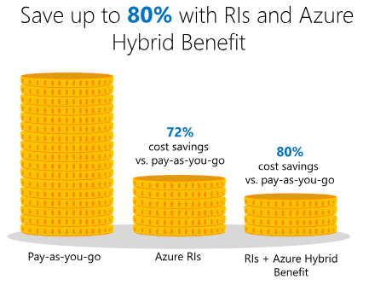
Reserved VM Instances (RIs)
Significantly reduce costs, with one-year or three-year terms on Windows and Linux virtual machines (VMs)
Exchange or cancel your Azure RIs at any time
Use instance size flexibility to use RIs across a VM groups
Integrated recommendations in Azure portal

Slide 41
Reserved Instance Recommendations

Slide 42
Low-priority VMs in VMSS
Related Session
THR2266 (Tue)
Eviction policies
Stop/Deallocate (default) – VM is deallocated, underlying disks are kept (and charged for)
Delete – VM and underlying disks are deleted
A scheduled event is raised 30s prior to eviction
No availability guarantees
1 fault domain, no service healing, no guaranteed capacity
Ideal for flexible, fault-tolerant workloads
Batch processing and compute intensive workloads
Container-based workloads, tolerant to VM pre-emption
Dev/Test workloads
Demo environments
az vmss create \
--resource-group myResourceGroup \
--name myScaleSet \
--image UbuntuLTS \
--upgrade-policy-mode automatic \
--admin-username azureuser \
--generate-ssh-keys \
--priority Low

Slide 43
Troubleshooting and Support

Slide 44
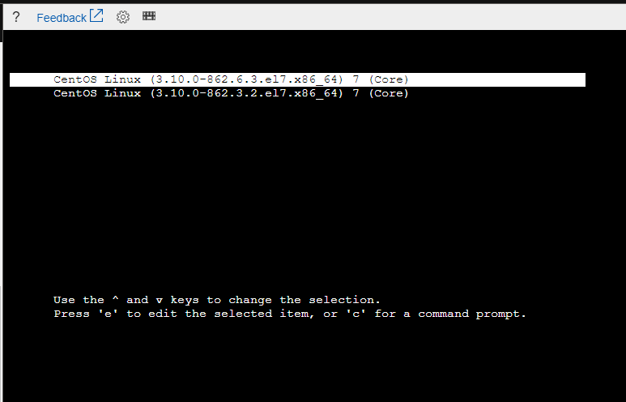
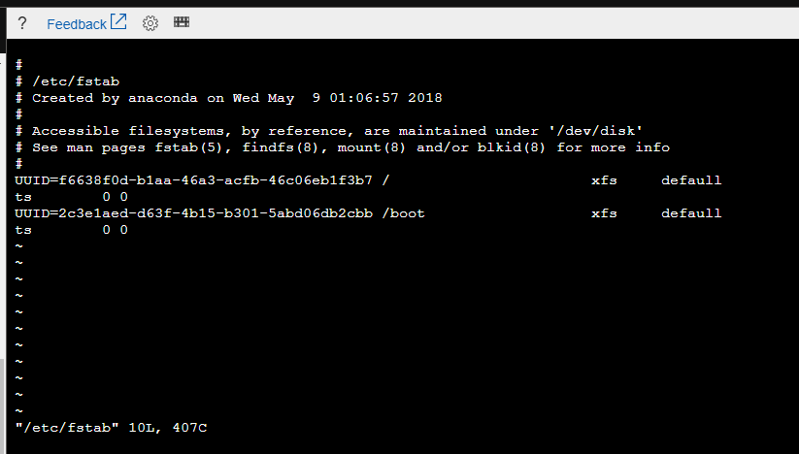
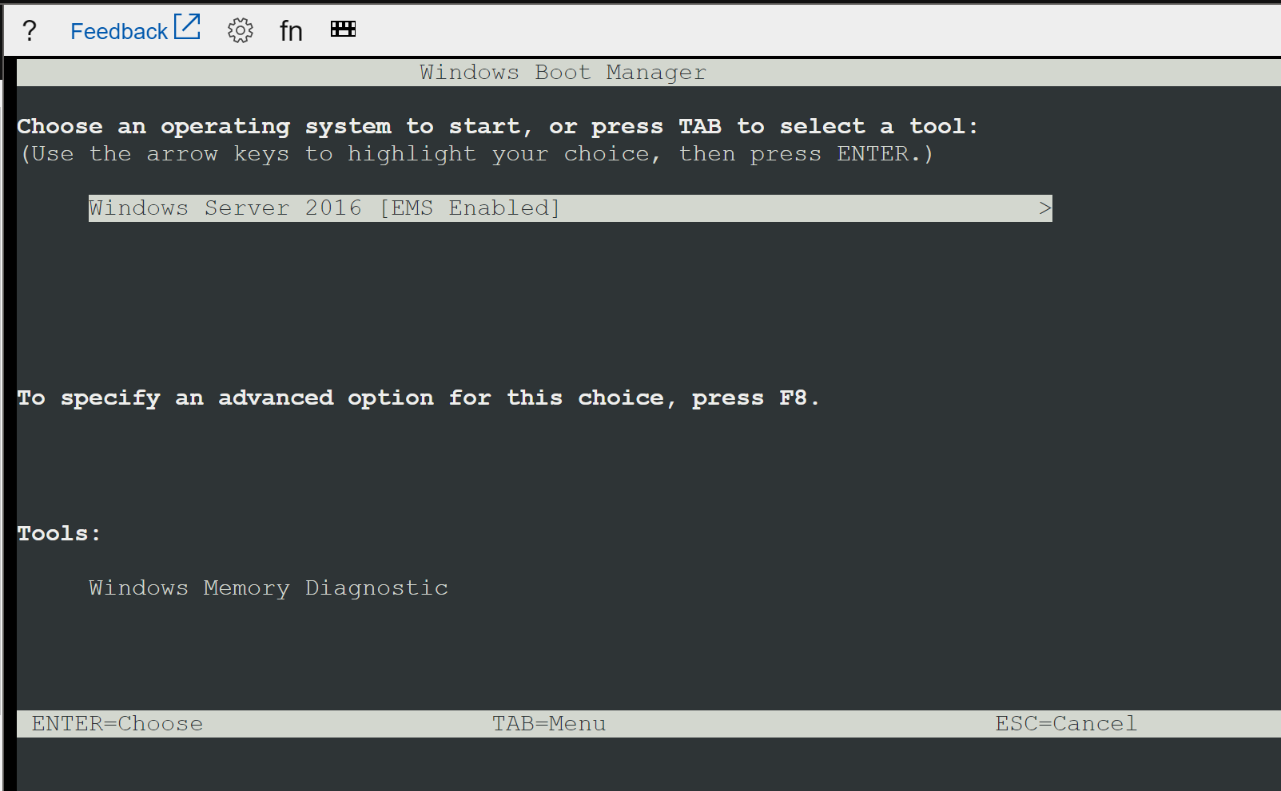
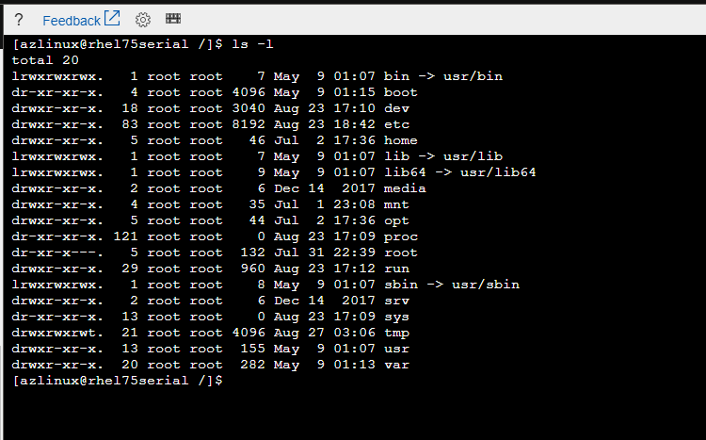
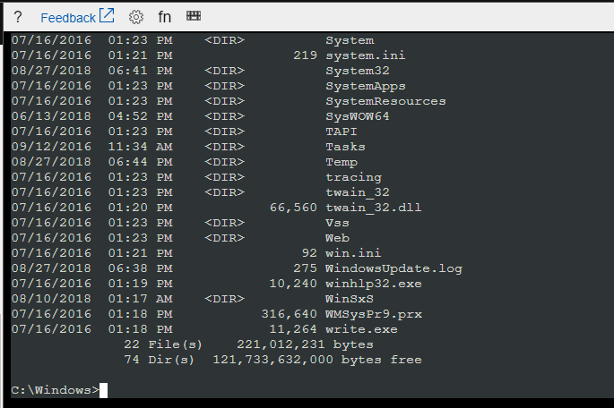
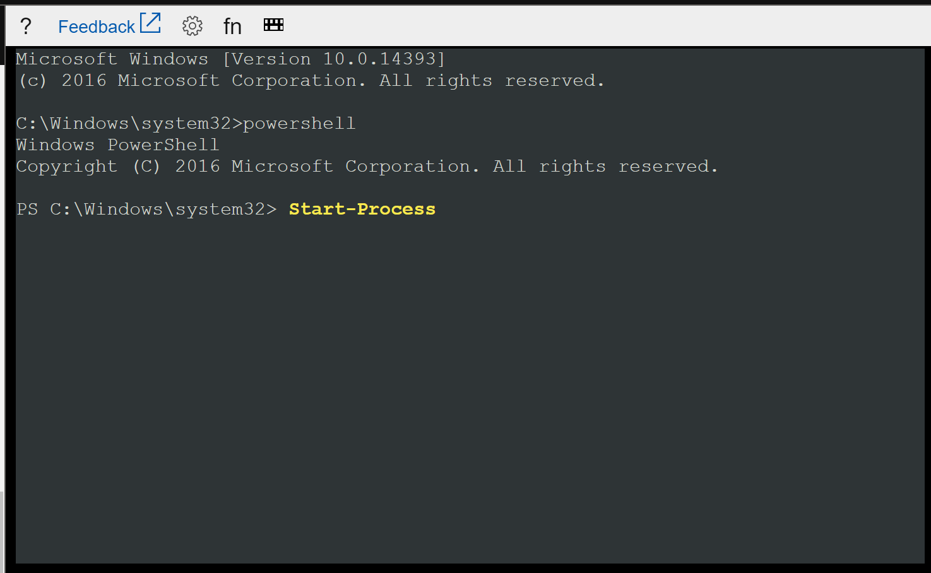
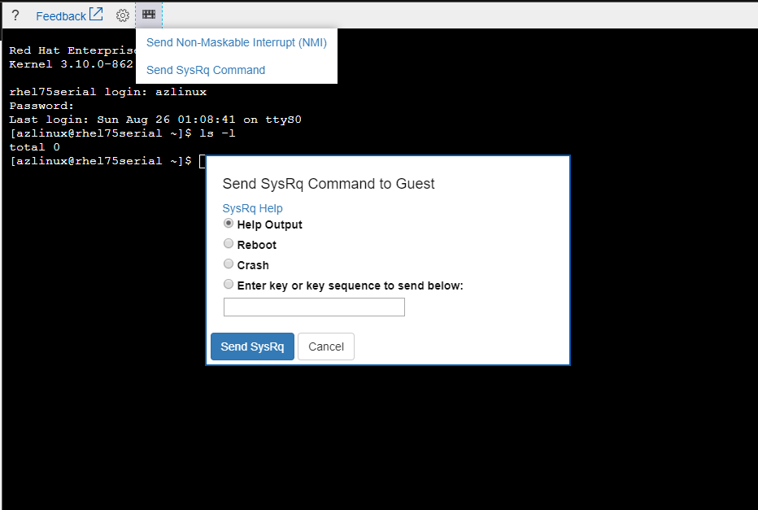
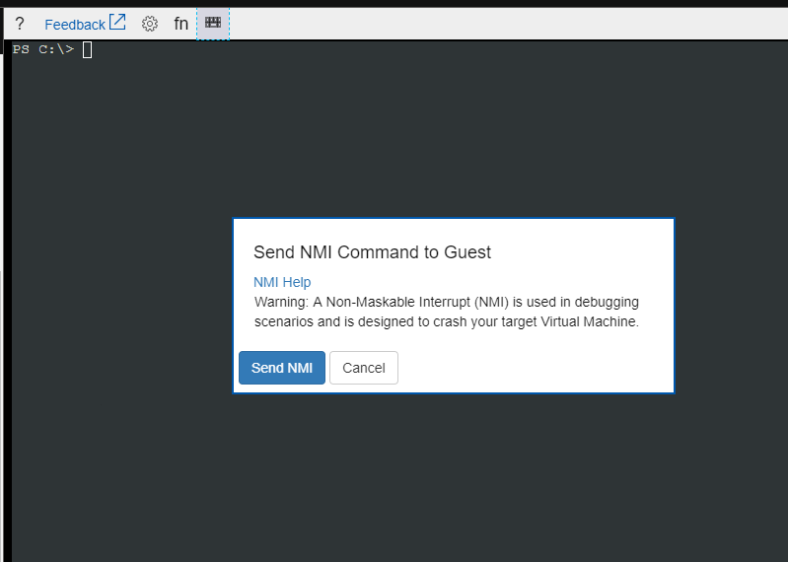
VM Serial Console
Related Session
THR3139 (Tue)
Linux
GRUB
Bash
vi
SysRq/NMI
Windows
Boot menu
CMD
PowerShell
NMI

Slide 45
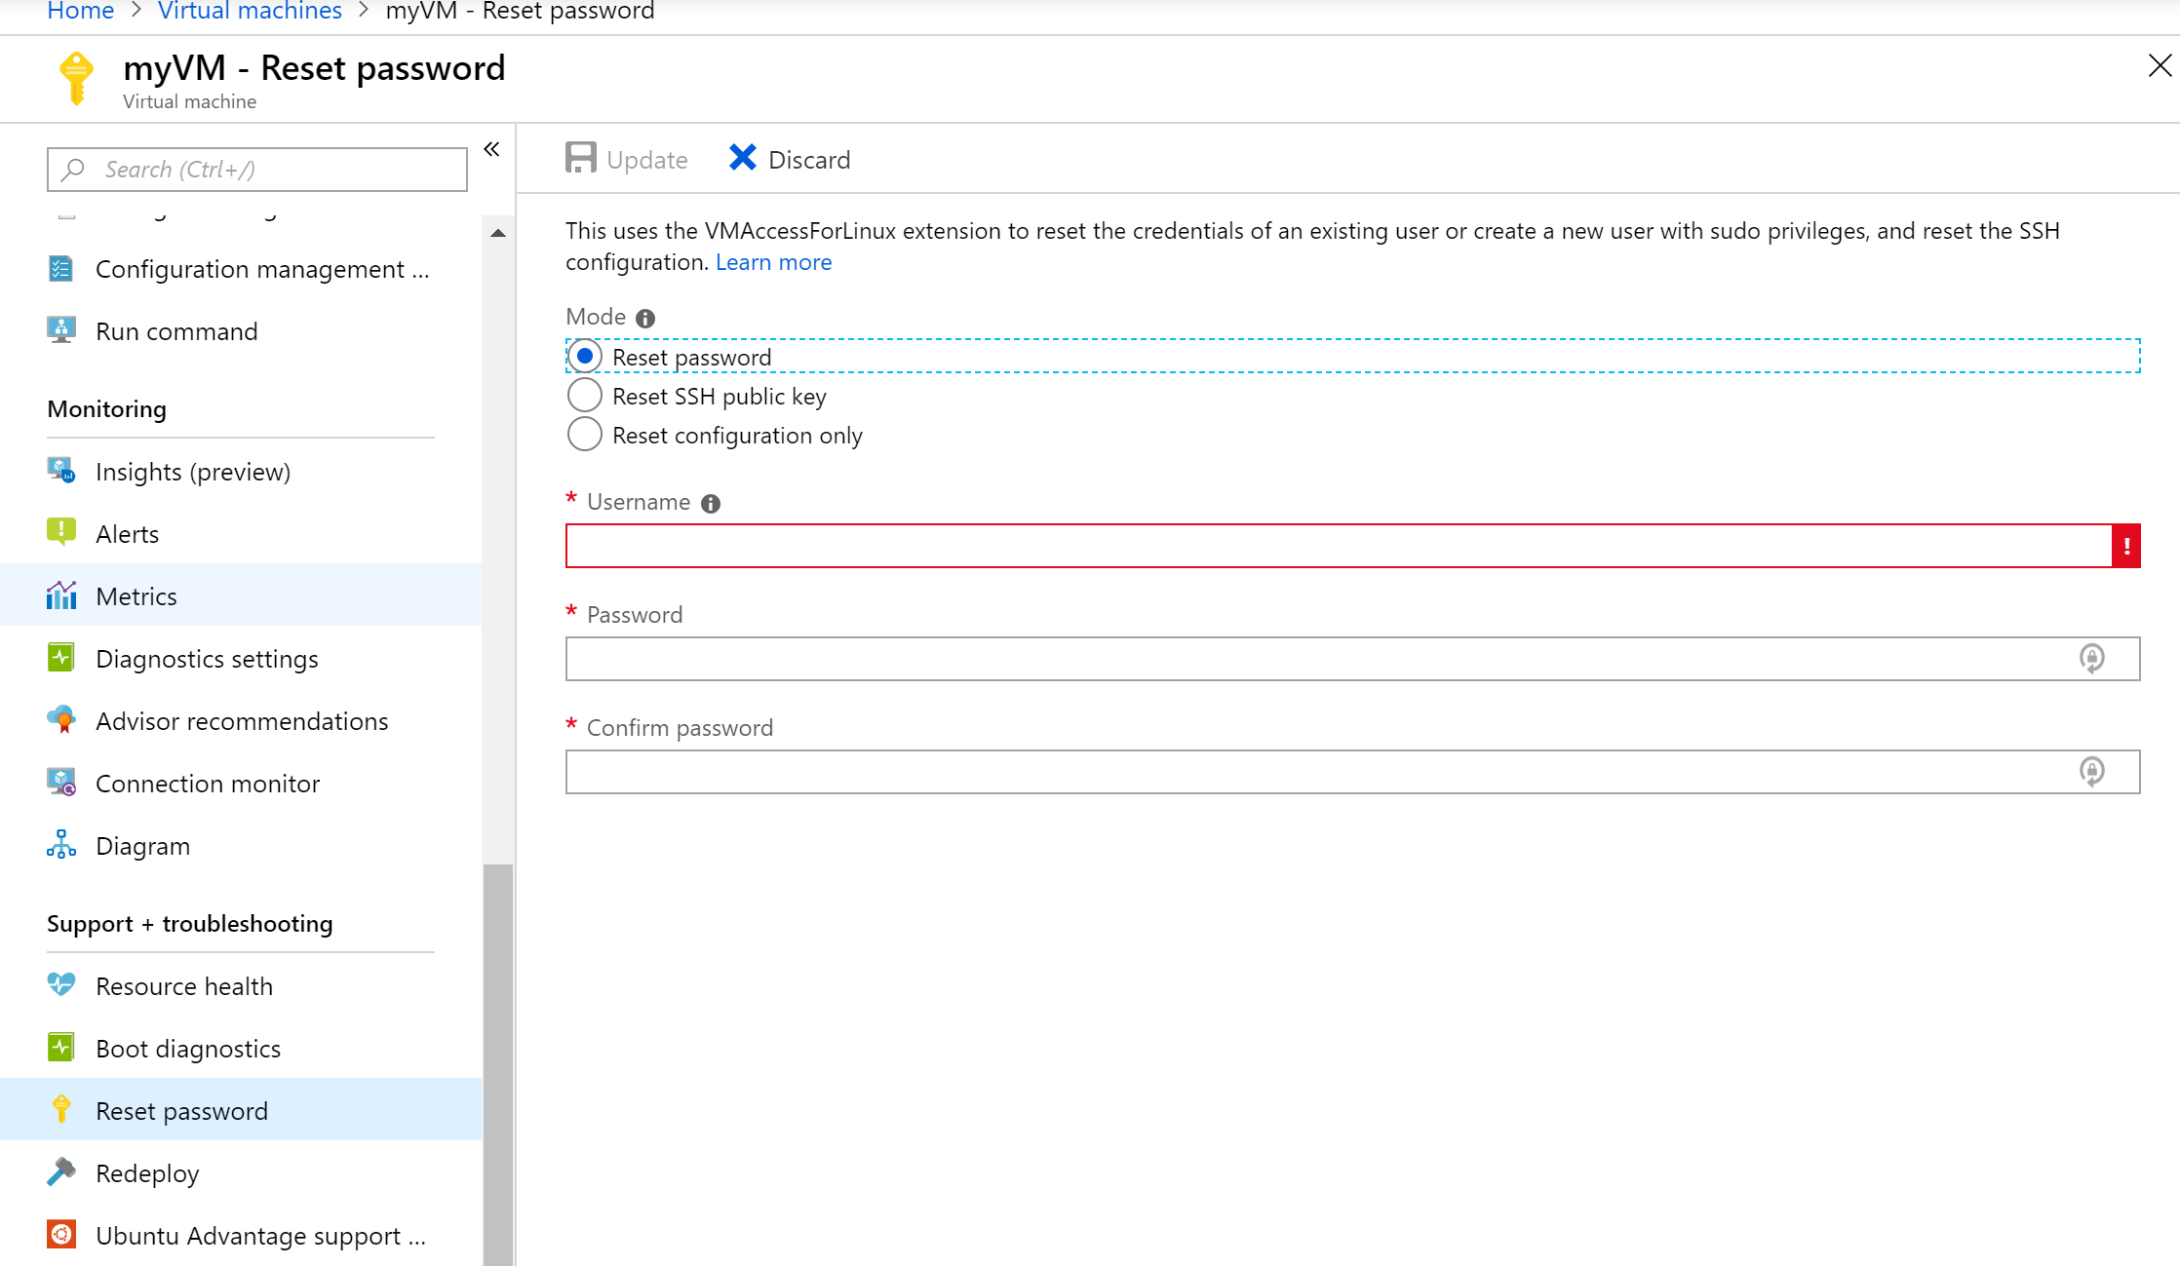
Reset Password
Related Session
THR3139 (Tue)
<Add Screenshots>

Slide 46
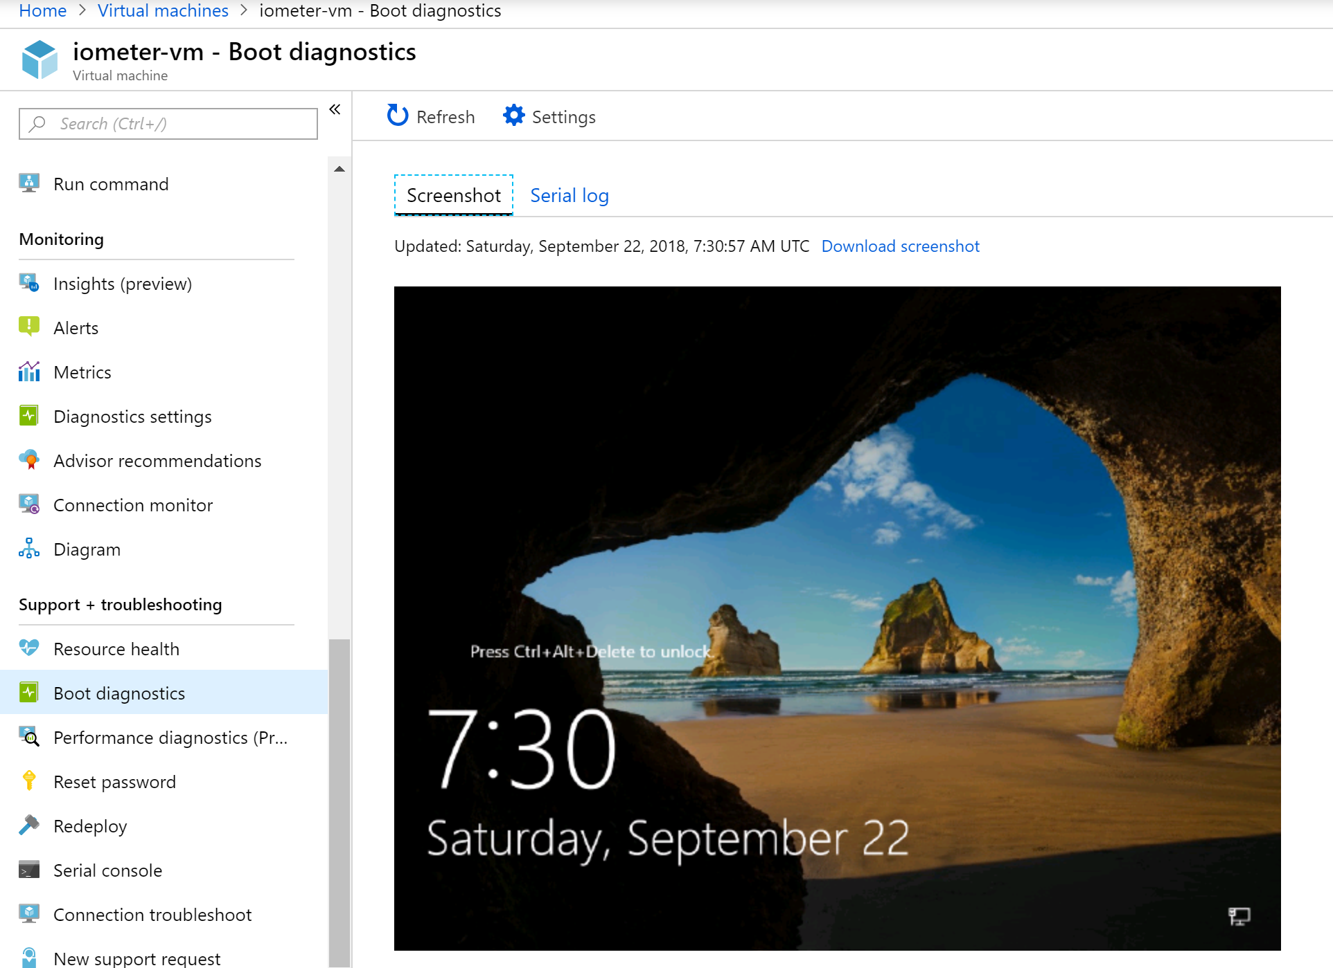
Screenshots
Related Session
THR3139 (Tue)
<Add Screenshots>

Slide 47
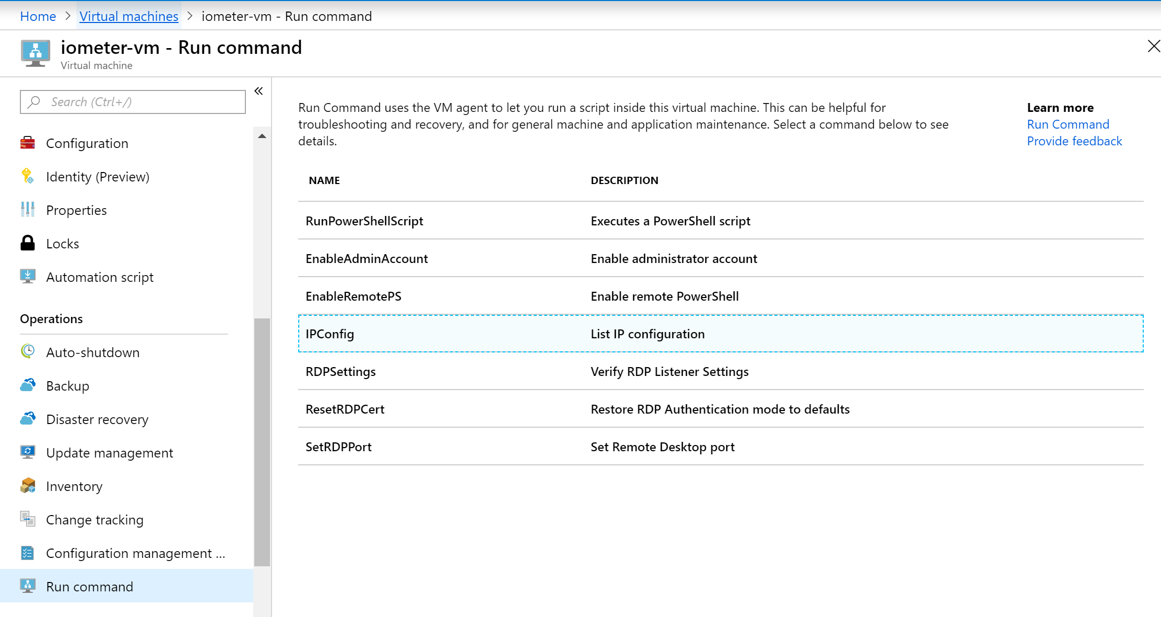
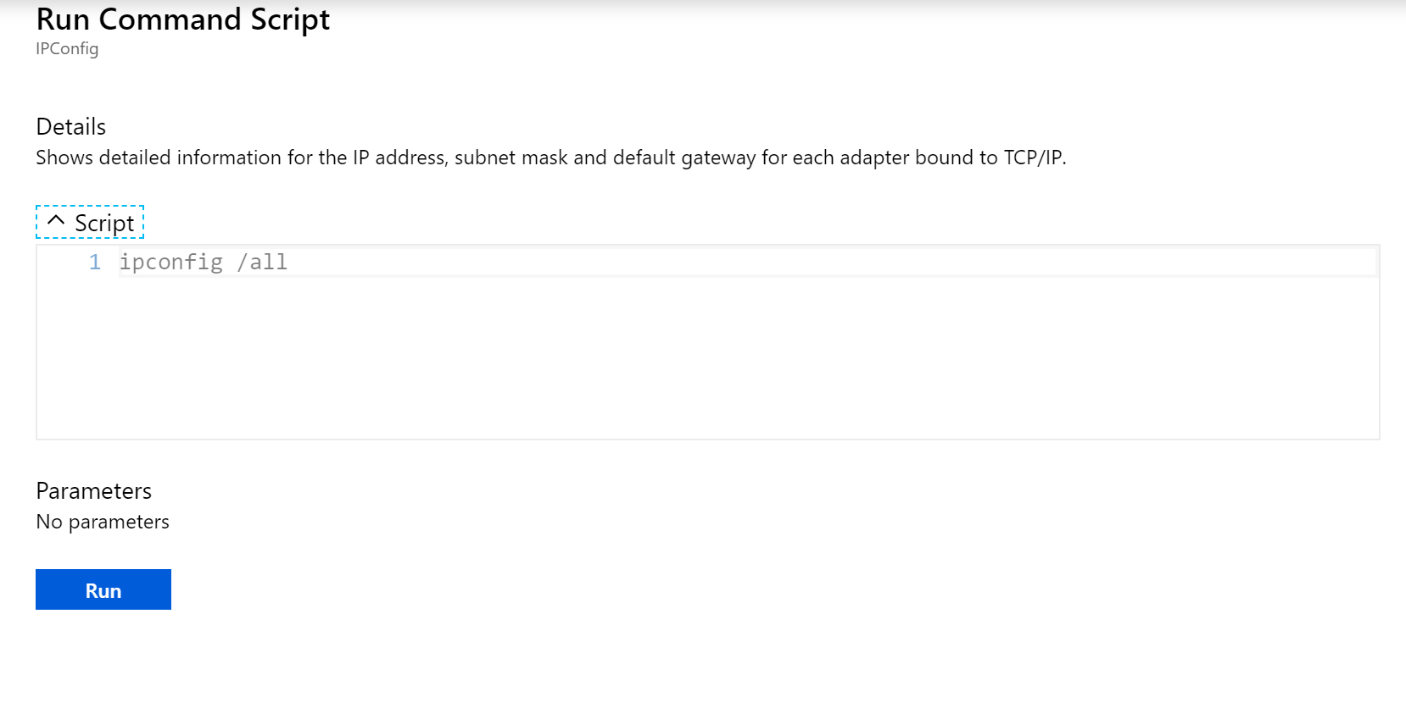
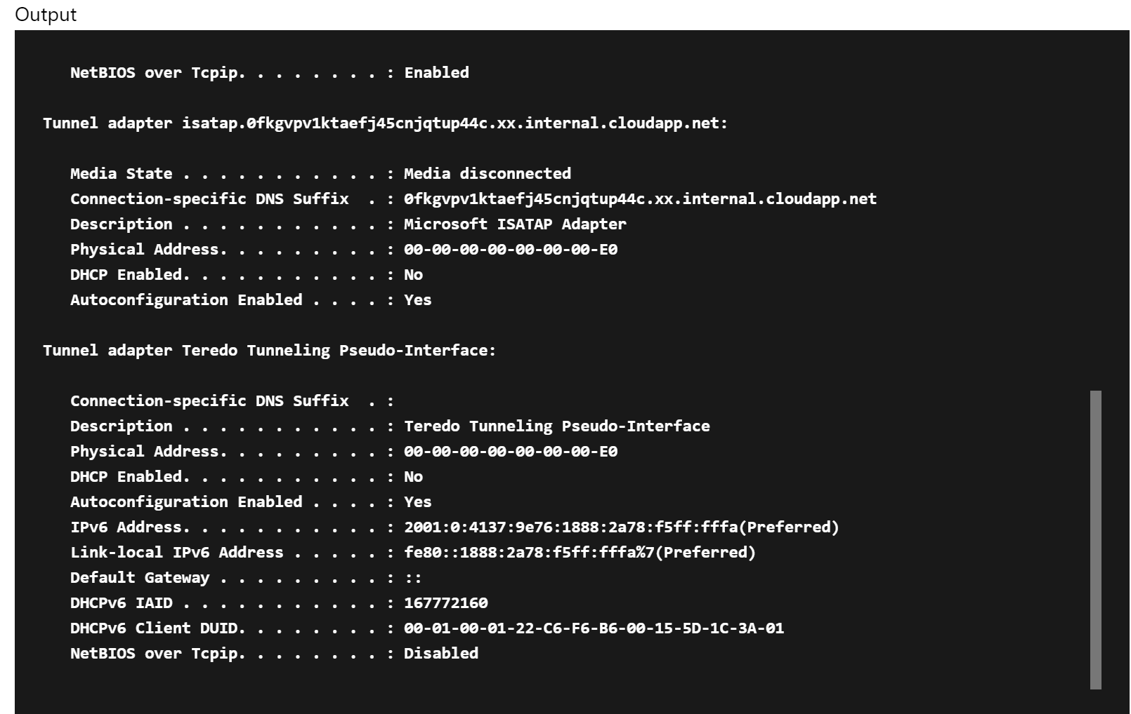
Run Command
Related Session
THR3139 (Tue)
Use PowerShell and CLI to list and invoke built-in scripts
Commands
Reset RDP Certificate
Reset Account Password
Set RDP Port
Enable Admin Account
Enable Remote PowerShell
Invoke a script from Portal

Slide 48
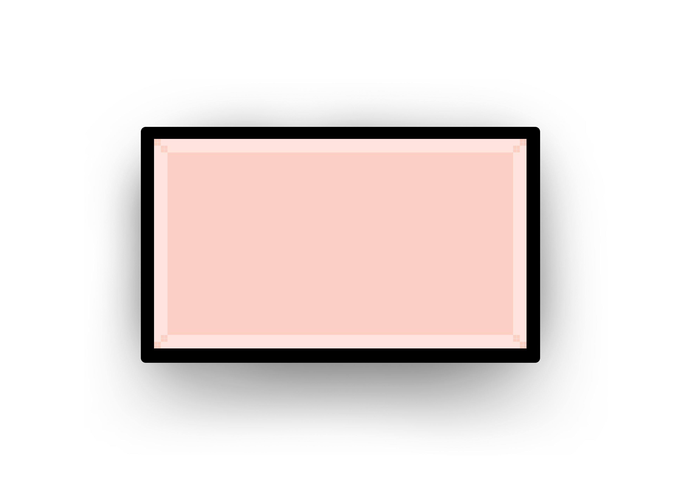
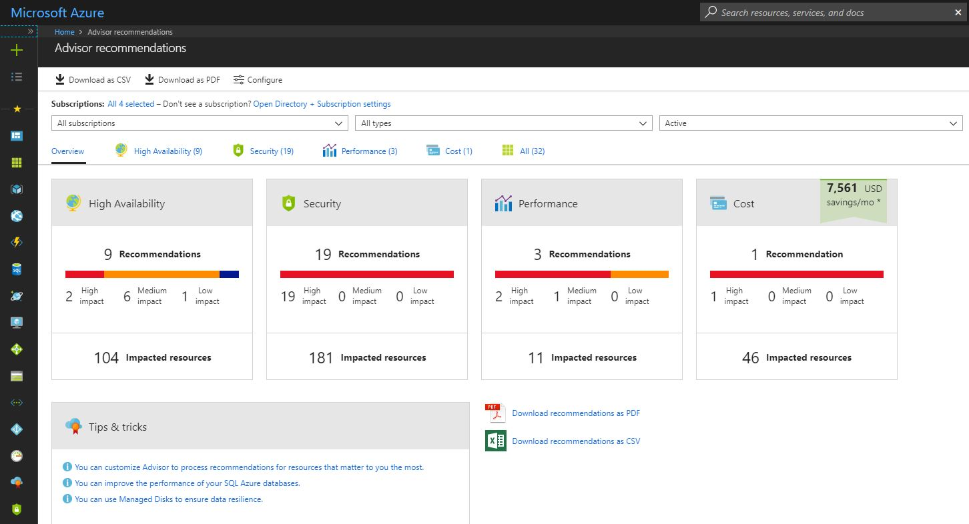
Azure Advisor: Your free, personalized guide to Azure proven practices
Optimize resources for availability, security, performance, and cost
Implement personalized recommendations with ease
Access proven practice optimizations at no additional cost
Review your Advisor recommendations in the Azure portal: https://aka.ms/azureadvisor

Slide 49
FastTrack for Azure Build Azure solutions quickly and confidently
Customer Benefits
Direct assistance from Azure engineers and program managers
Use proven practices and tools from real customer experiences
Accelerated deployment to full production of Azure solutions
Discovery: Validate project scope, vision, requirements and assess architectural needs
Solution Enablement: Guidance on solution architecture design using proven practices and design principles, in addition to providing advice and assistance to facilitate solution PoC and dev/test environments
Deployment: Support in-house customer and/or partner led deployment of Azure solution
Continuous Partnership: Provide periodic check-ins and address additional workloads and deployment needs
Learn more:
FastTrack for Azure booth @ Deployment area near the Expo center landmark
Azure.com/FastTrack

